Slide 1
EIP-AGRI and the Service point
CORE Organic seminar
Willemine Brinkman, EIP-AGRI Service Point Stockholm, 1 October 2014

Slide 2
EIP-AGRI in a nutshell
Aim: To foster a competitive and sustainable agriculture and forestry sector that "achieves more from less“
Approach: Closing the innovation gap between research and practice (forming partnerships) by:
Using the interactive innovation model ("two-way road")
Linking actors via an EIP Network
Notes:
The EIP AGRI is the agricultural European Innovation Partnership. It is one of the five EIPs set up by the European union. The EIP AGRI assists the agriculture and forestry sectors to become more productive and sustainable, and able to tackle challenges such as competition,volatile prices, environmental rules, and climate change. Within the EU, the EIP AGRI is supported by two policies; rural development and Horizon 2020, the EU policy for research and innovation.
New approach under the Europe 2020 Strategy for smart, sustainable and inclusive growth (COM (2010) 2020)
Flagship Initiative: "Innovation Union": "European Innovation Partnerships" to address major societal challenges of today (climate change, energy and resource efficiency, health, as well as demographic change)
EIP AGRI: Part of a group of five EIP´s
(Other EIP´s: Active & Healthy Ageing, Smart Cities and Communities, Water, Raw Materials)

Slide 3
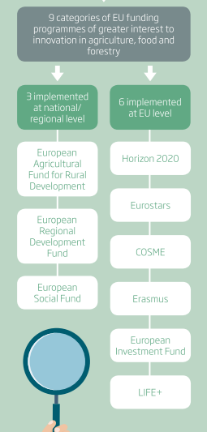
EIP-AGRI in a nutshell
Funding: Existing Union policies:
"Rural development regulation" (EAFRD)
"Horizon 2020"
No double funding!
Notes:
The EIP AGRI is the agricultural European Innovation Partnership. It is one of the five EIPs set up by the European union. The EIP AGRI assists the agriculture and forestry sectors to become more productive and sustainable, and able to tackle challenges such as competition,volatile prices, environmental rules, and climate change. Within the EU, the EIP AGRI is supported by two policies; rural development and Horizon 2020, the EU policy for research and innovation.
New approach under the Europe 2020 Strategy for smart, sustainable and inclusive growth (COM (2010) 2020)
Flagship Initiative: "Innovation Union": "European Innovation Partnerships" to address major societal challenges of today (climate change, energy and resource efficiency, health, as well as demographic change)
EIP AGRI: Part of a group of five EIP´s
(Other EIP´s: Active & Healthy Ageing, Smart Cities and Communities, Water, Raw Materials)

Slide 4
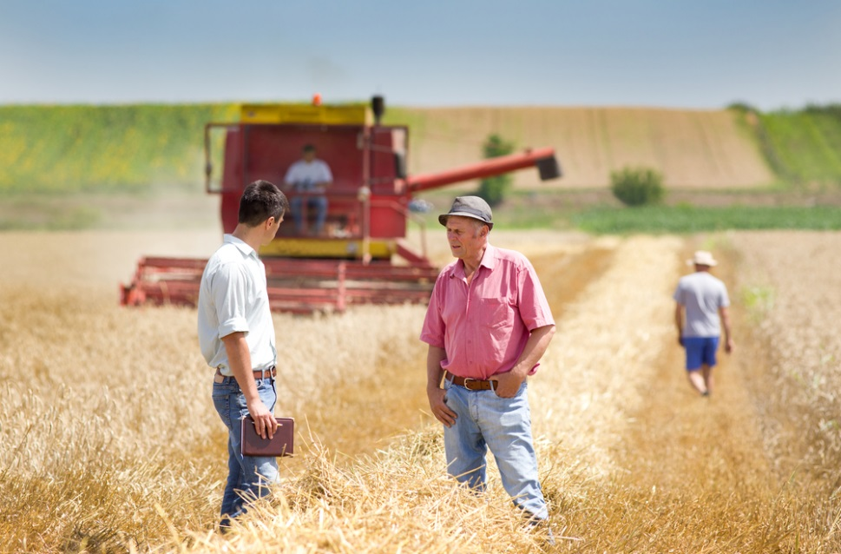
EIP-AGRI: Interactive Innovation Model
Beyond speeding up transfer:
Partnerships and bottom-up approaches
Operational Groups
shape existing knowledge into solutions
Co-ownership: solutions put into practice very quickly
help to target the research agenda
Notes:
Far beyond speeding up transfer from laboratory to market
Forming partnerships - using bottom-up approaches and linking farmers, advisors, researchers, businesses, and other actors in Operational Groups
New insights and ideas, shape existing knowledge into solutions
Solutions put into practice very quickly thanks to the co-ownership generated during projects.
Help to target the research agenda.

Slide 5
Means to implement the EIP-AGRI
Rural Development Programmes
Operational Groups
project funding
innovation support services
European Union Research Policy - Horizon 2020
research projects involving on-farm experiments
multi-actor projects and thematic networks
Notes:
Rural Development Programmes:
Setting up "operational groups" (key actors of the EIP AGRI)
Combining the setting up of operational groups with project funding (investment, knowledge transfer, advisory services)
Establishing "innovation support services", e.g. to facilitate the formation of operational groups
European Union Research Policy (Horizon 2020)
Funding research projects, also involving on-farm experiments, to enhance the knowledge base for innovation
Interactive formats such as multi-actor projects and thematic networks

Slide 6
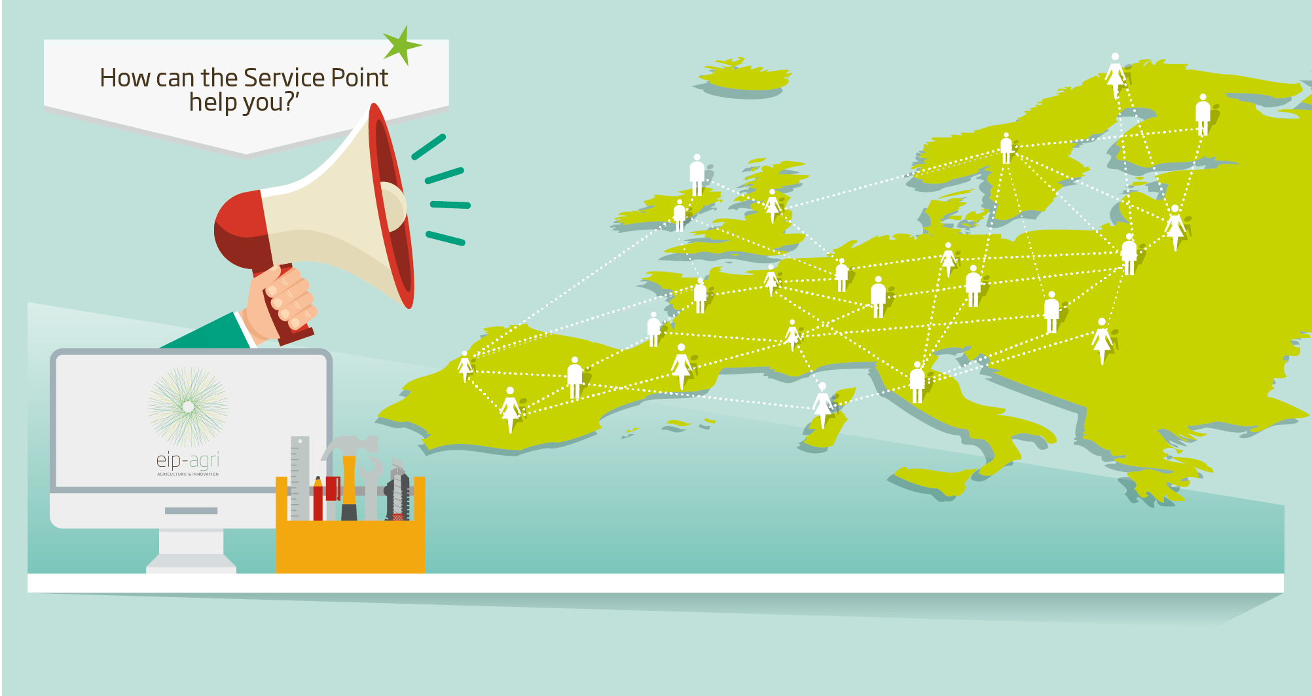
EIP-AGRI connects all actors within the EIP-AGRI Network
Notes:
The EIP-AGRI Network is currently being built, it needs to be promoted and facilitated. At EU level, this is where the EIP-AGRI Service Point comes in: linking people, sharing information to build the EIP-AGRI Network and make it work.
How? By enhancing communication, dissemination and knowledge flows, helping to bring partners together and collecting practice needs, the EIP-AGRI Service Point provides the tools to make it easier for the innovation actors to find each other and to work together.
The idea is that the SP helps spread agricultural innovations across europe faster and more widely

Slide 7
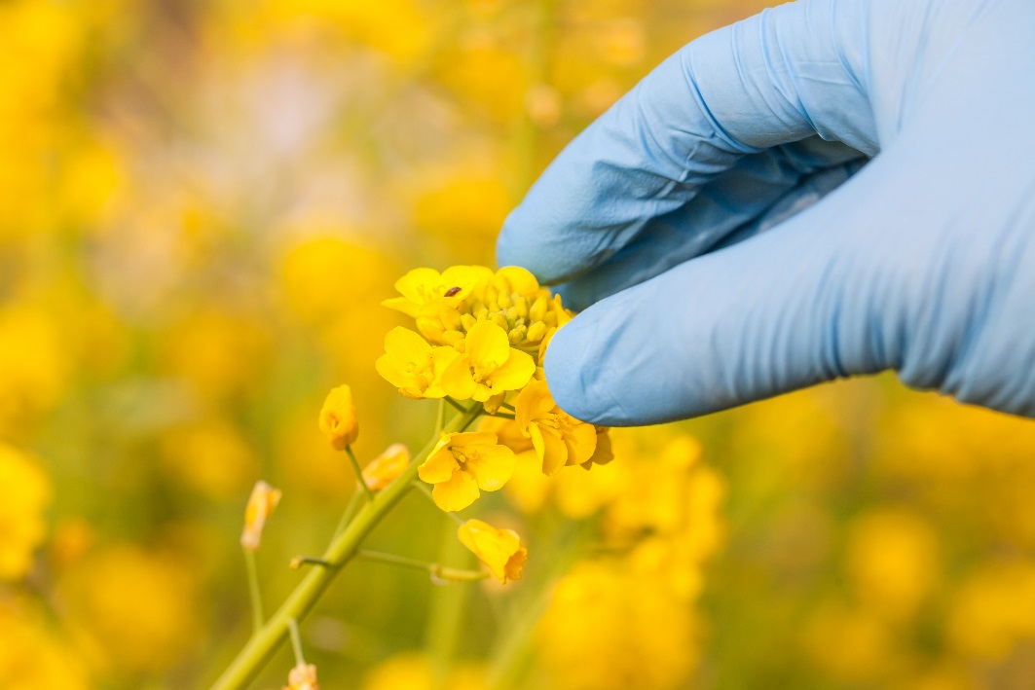
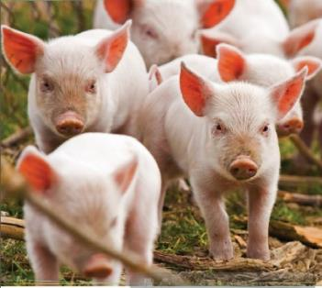
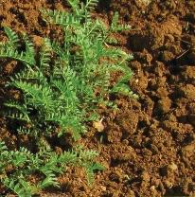
EIP-AGRI Focus Groups tackling agricultural challenges
Open calls for interest of participation
20 participants, different types of actors
Short duration, focused
Inspiration to set up Operational Groups
Practical solutions
Research needs
Notes:
Focus Groups - dealing with specific agricultural challenges – building blocks for the EIP-AGRI network.
These FG are required:
•to take stock of the state of the art of practice in the field, listing problems and opportunities;
•to take stock of the state of the art of research in this field, summarizing possible solutions to those problems;
•to identify needs from practice and propose directions for further research;
•to propose priorities for innovative actions by suggesting potential practical operational groups or other project formats to test solutions and opportunities.
FG bring together Practice and Research and, by exchanging practical knowledge, identify priorities for innovative actions, generate ideas for operational groups, identify research needs from practice and suggest projects to test solutions.
How are these FG organised? Every time a new FG is to start, DG AGRI opens a call for expression of interest: who ever is interested in participating needs to apply. All applications are analysed and 20 participants are selected by DG AGRI while looking for a balanced mix of types of actors.
One of the main characteristics of these FG is that they have a short duration (as a standard procedure, they last one year and have 2 face-to-face meetings, but participants are requested to do some work inbetween meetings).
Also, they are well focused on a specific subjects coming from existing problems or opportunities in the field. Topics are always very concrete and practice-oriented, addressing real challenges such as: how to optimize arable yields in organic farming, how to make protein crops in EU farming more competitive, how to reduce the use of antibiotics (the correct term is antimicrobials) in the pig sector, How can cooperation between the different types of stakeholders be promoted in genetic resources, How to improve the soil organic matter content in Mediterranean regions, what cost-effective IPM solutions are there for Brassica, etc.
The latest call for experts for focus groups was published in July with the deadline of 8th of September, by early October experts will be selected and informed personally + information will be available on the website.

Slide 8
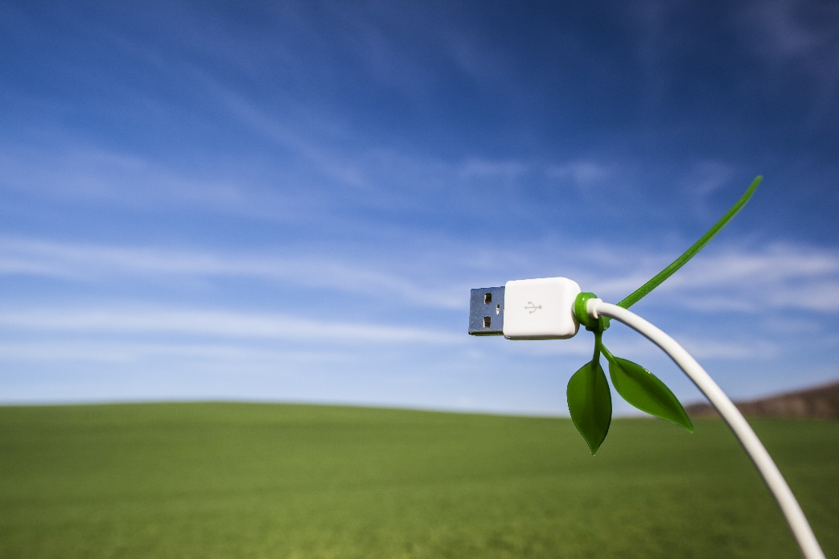
EIP-AGRI Focus Groups tackling agricultural challenges
Organic Farming
Protein Crops
Reduction of anti-biotic use in the pig sector
Cooperation models in genetic resources
Soil Organic Matter content in Mediterranean soils
Integrated Pest Management in Brassica
..more on the website
Notes:
Note (if someone asks) :
1. Organic farming,
2. Protein crops (Why is EU farming in protein crops not able to deliver and not competitive?),
3. Reduction of anti-biotic use in the pig sector,
4. Cooperation models in genetic resources,
5. Soil organic matter content in Mediterranean,
6. IPM in Brassica.
7. High Nature Value (HNV) farming profitability - How to make HNV farming more profitable for its farmers
8. Mainstreaming precision farming– How to organize the capture data to facilitate the application of precision farming for an optimization of inputs and yields.
9. Profitability of permanent grassland - How to manage permanent grassland in a way that combines profitability, carbon storage and biodiversity.
10. Fertiliser efficiency, focus on horticulture in open field – How to resolve the conflict between crop quality demands and legislative requirements through innovative fertilization and nutrient recycling.
These new focus groups will address the following topics:
11 Optimising yields through ecological focus areas - How to make the best use of ecological focus areas for competitiveness of arable crops.
12 Alternative/ innovative supply chains – How to optimise the supply chain to increase both farm income and consumers’ choice in outlets.
13 IPM practices for soil disease suppression - What practical soil disease suppression techniques are ready to use in which crops? What alternative techniques for soil fumigation are ready to apply?

Slide 9
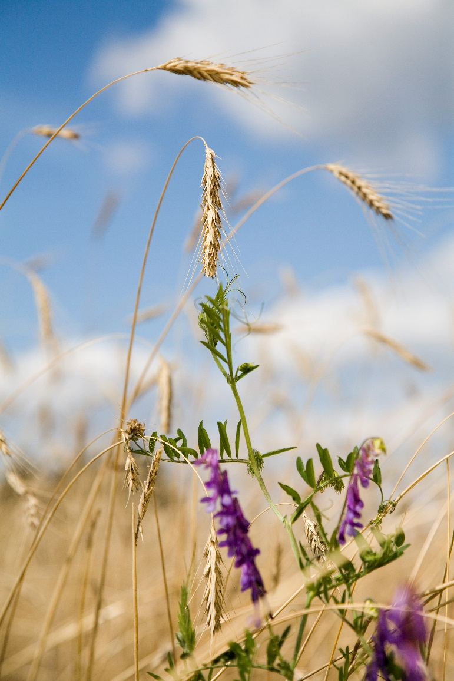
Focus Group: Optimising arable yields in Organic Arable Farming
Why do the yields on Organic arable farms vary so much, and how can this yield gap be minimised?
proposals for action
examples of practical solutions
suggestions for the setting-up of Operational Groups
research topics and methodologies
proposals for dissemination, training and education programmes

Slide 10
Focus Group: Optimising arable yields in Organic Arable Farming
Final report and fact sheet
https://ec.europa.eu/eip/agriculture/en/content/organic-farming-optimising-arable-yields
https://ec.europa.eu/eip/agriculture/sites/agri-eip/files/eip-agri_fact_sheet_organic_farming_web.pdf

Slide 11
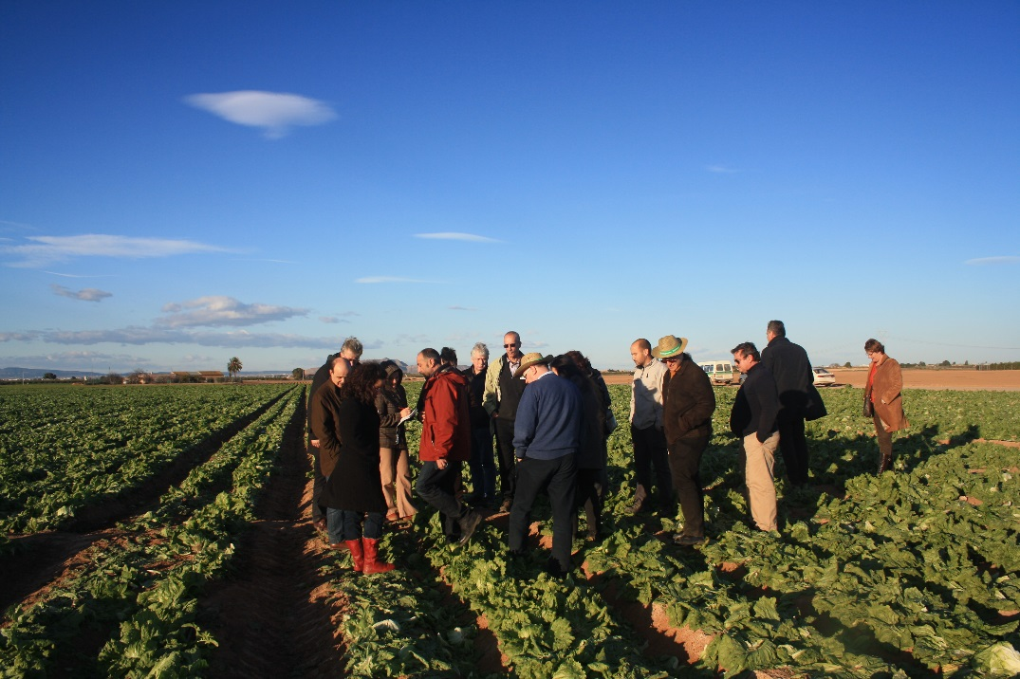
Focus Groups: opportunities for ERANETs
propose FG themes
propose coordinating experts
support experts to apply by disseminating calls
take up the outcomes of the Focus Groups
Call for 2015 FG themes is open until today - 1 October
form available at the website

Slide 12
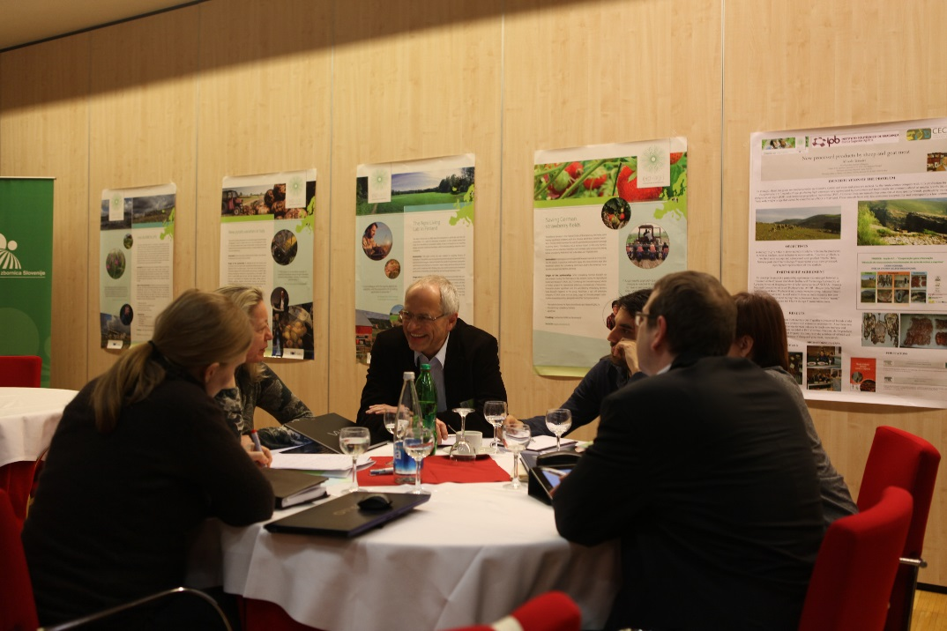
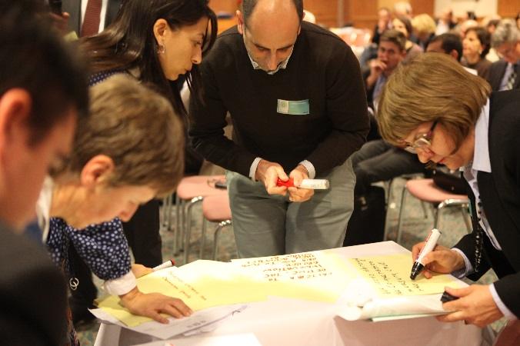
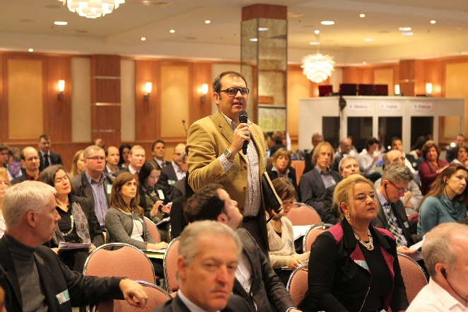
Seminars, workshops
Seminars for Managing Authorities (MA) in 2013
Workshops (WS) about Horizon 2020, setting up Operational Groups
Upcoming events:
MA seminar in November
Protein crops WS in November
Bio-security WS in January 2015
For latest updates please subscribe for Newsletter/follow @EIP-AGRI_SP on Twitter

Slide 13
EIP-AGRI website www.eip-agri.eu The one-stop-shop for agricultural innovation
SHARE WITH US
SEARCH AND FIND
FOCUS ON
DEEPEN YOUR KNOWLEDGE
STAY UP TO DATE
MY EIP-AGRI
Notes:
Networking
Access to information
Knowledge sharing
Best practice
Reporting and outcomes
So far, EIP-AGRI information was published via the EC website. Now we are proud to present a brand new, interactive EIP-AGRI website, which provides a new interactive innovation platform for project databases, partner search and an overview of funding opportunities for innovation projects.
The Website will allow you to:
There will be also an application - MY EIP-AGRI – that will connect you to your own EIP-AGRI dashboard, enabling you to follow the information and people you are interested in – to be made available soon.
SHARE information about you, your projects and project ideas, research needs,
SEARCH for funding opportunities, partners, interesting projects,
Get information (FOCUS ON) about practical innovative solutions to problems and opportunities provided in the EIP-AGRI Focus Group chapter
Access different EIP-AGRI related publications in our library
STAY UP TO DATE on innovation related agricultural topics and read about the latest EIP-AGRI news and events
Please note that the website is currently being developed further, and your feedback on what is useful, and on how we can further improve it will be most welcome

Slide 14
Opportunities for CORE Organic projects?
Use the network to:
Search for people
Search on research needs
Find inspiration
Share your results
Register on the website and start searching the network today!
www.eip-agri.eu

Slide 15
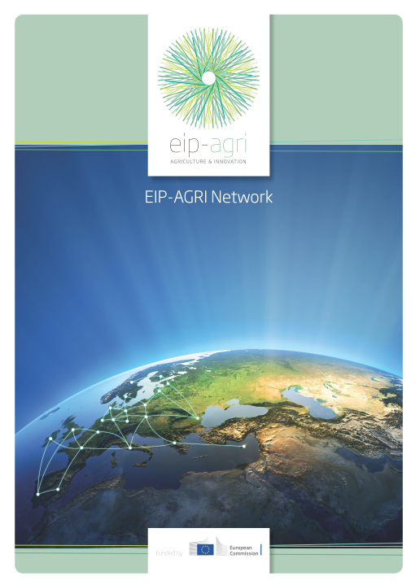
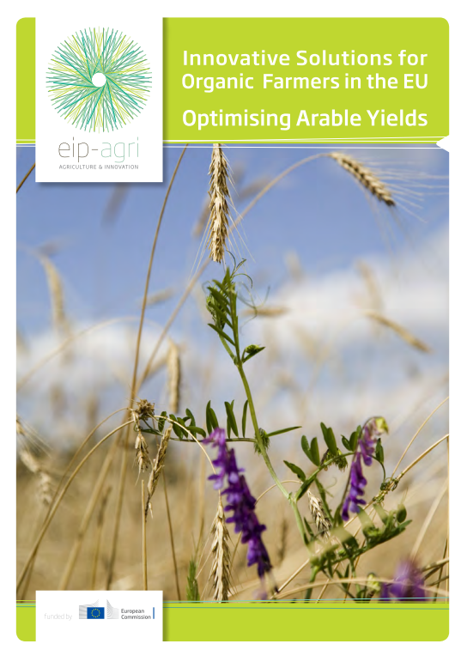
EIP-AGRI Publications

Slide 16
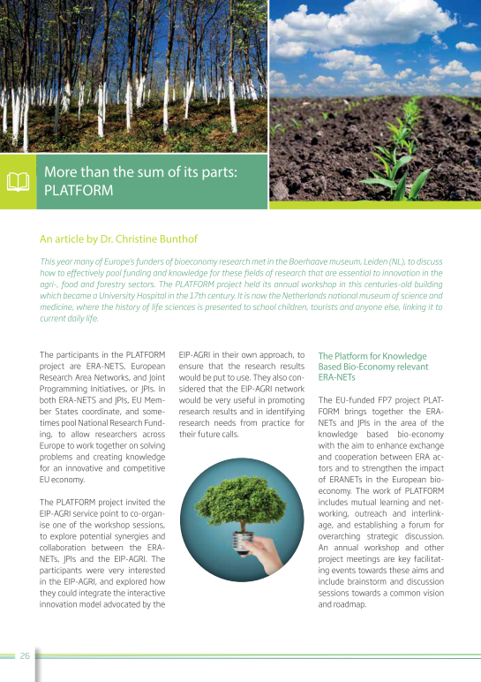
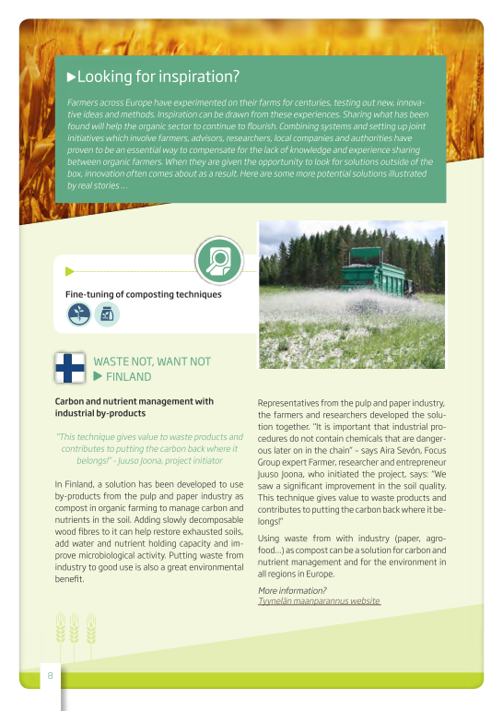
Use EIP-AGRI Publications to share your results

Slide 17
Monthly newsletters
Event results
Innovative projects
Best practices
Focus Groups
Publications and fact sheets
Upcoming events
Subscribe:
http://ec.europa.eu/eip/agriculture/en/content/subscribe-newsletter
Notes:
How can we help you disseminate: for instance through our monthly Newsletters, Factsheets
disseminate good innovative projects
Present ERANETs
advertise ERANET calls and events
Promote innovative results that can help make agriculture and forestry more sustainable
Please send your proposals for topics to be covered in publications to servicepoint@eip-agri.eu

Slide 18
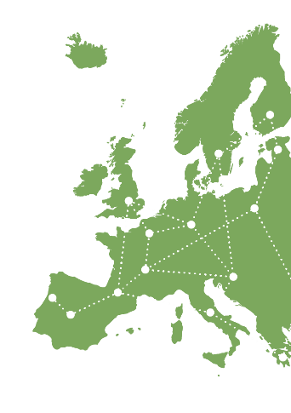
Thank you for your attention!
servicepoint@eip-agri.eu
+32 2 543 73 48
EIP-AGRI Service Point Avenue de la Toison d’Or 72 1060 Brussel Belgium
www.eip-agri.eu

